Slide 1
A “Global” History of South Asia (3000 BCE – 2000 CE)
Lecture One: Historiographic Challenges in South Asian Architectural History
Dr. Adnan Morsehd
Associate Professor, School of Architecture and Planning
Catholic University of America, Washington, DC
Notes:
A “Global” History of South Asia (3000 BCE – 2000 CE)
Lecture One:
Historiographic Challenges in South Asian Architectural History
These lectures revisit architectural histories (itihasas) of the Indian Subcontinent from multidisciplinary, cross-geographical, and interpretive perspectives, supported by a new body of scholarship and archaeological data. The word for “history” in Sanskrit is itihasa, which has traditionally meant “that’s what happened” or “so indeed it was.” Yet, iti (as in itihasa) is often used in a Sanskrit sense of “end quote.” Itihasa, therefore, in its traditional usage has often been infused with a host of subjectivities. In other words, it implies not so much what happened as what people said or thought happened.
Taking clues from the politics of itihasa and its fact/fiction problematics, these lectures look at familiar and neglected materials of Subcontinental architecture and cities, with a view to creating a fuller and nuanced body of architectural-survey teaching modules, to be used at both undergraduate and graduate levels.
The epistemological framing of the lectures is based on bibechana, which derives from the Sanskrit root verb bich, literally meaning “to separate, judge” (for instance, separate fact from fiction and judge the veracity of the narrative). Bibechana implies “investigation,” “judgement,” or “ascertainment after consideration.”
The meanings of the word work in two helpful methodological ways in these lectures: first, it can inculcate a disinterested self in the production of knowledge and, second, it can consider multiple narratives (purana, itivritta, akhyayika, udaharana, shastra, etc.) simultaneously, while presenting the realm of plausibility without being deterministic.
In many ways, such a methodological approach could offer viable alternatives to canonical architectural history surveys in the Indian Subcontinent, the historiographic framework of which was created by the works of such British historians as James Fergusson, Percy Brown, and Banister Fletcher. Their Eurocentric histories drew much postcolonial criticism since the 1980s onward. The key intellectual challenges for writing “global” architectural histories of South Asia in professional architectural schools have been the following: (a) How does one write architectural histories that eliminate the problems of
Eurocentrism, while not diminishing the differences between cultural practices? (b) How to write histories without a Eurocentric teleology? (c) How could one be inclusive of different building practices and at the same time demonstrate their interrelationship through a global network of trading routes, cultural exchanges, military conquest, pilgrimage routes, etc.? How does architectural histories reflect the debates concerning the politics of modernity, nationalism, tradition, globalization, and identity? This lecture module addresses these questions.
This module includes the following five lectures (to be integrated with Vikram Prakash’s module on South Asia)
Lecture 1: Historiographic Challenges in South Asian Architectural History
Lecture 2: The Mughal Sphere of Influence: From Lahore to Bengal
Lecture 3: British Raj and Imagining India
Lecture 4: The Architecture of Empire
Lecture 5: The Politics of Post-Partition Modernism and Nationalism

Slide 2
History of Architectural Education in the Indian Subcontinent
In 1947, the year of the Indian Partition, there were 3 schools of architecture in India and one in (West) Pakistan. None in East Pakistan.
These schools began mostly as hands-on, craft training institutes in the mid-nineteenth century.
Examples: Sir J.J. School of Art in Mumbai in 1857 and the New School of Art in Lahore in 1875.
Architecture programs were modeled after those in Britain and the United States.
Architectural history courses were based on how the British "discovered" the art and architecture of South Asia (formation of the Asiatic Society in 1784; the Archaeological Survey of India in 1870)
Notes:
Information source: Hosagrahar, Jyoti, “South Asia: Looking Back, Moving Ahead-History and Modernization,” Journal of the
Society of Architectural Historians, Vol. 61, No. 3 (Sep., 2002), pp. 355-369.

Slide 3
Some “standard” works that created the pedagogical models of architectural history surveys in the Indian Subcontinent
James Fergusson's History of Indian and Eastern Architecture (1876)
Percy Brown's Indian Architecture (vol. 1, Buddhist and Hindu Periods, vol. 2, Islamic Period) (1942)
Satish Grover's The Architecture of India (vol. 1, Buddhist and Hindu, vol. 2, Islamic)
- Brown draws heavily on Fergusson
- Grover offers a somewhat more spatial interpretation of Brown
Notes:
Some “standard” works that created the pedagogical models of architectural history surveys in the Indian Subcontinent.
“Colonial pedagogy”: Problems of Architectural Education in the Indian Subcontinent.

Slide 4
Works that have also been influential….
Andreas Volwahsen's Living Architecture (vol. 1, Indian, vol. 2, Islamic Indian)
Stella Kramrisch's pioneering book on temple architecture
Romila Thapar’s study of ancient India
Vidya Dehejia's book on Orissan temples
George Michell's work on the Hindu Temple
Notes:
Works that are influential….

Slide 5
The “global” was/is missing…
Courses on South Asian architectural history generally follow a standard chronology:
The Indus Valley civilization, 3000-2000 BCE
Vedic and Mauryan to the beginning of Buddhist architecture in 250 BCE
Buddhist architecture is followed until about 650 CE
The development of Hindu temples is traced from 450 C.E. to the thirteenth century (some instructors go up to the seventeenth).
The Islamic architecture studied usually spans from the early decades of the eighth century to the end of the seventeenth century.
Colonial
Post-Independence Modern
Notes:
The “global” is missing…
An ironic postcolonial response to Eurocentric models of architectural history surveys was that surveys have been taught during the post-independence period often from an inward-looking, covert nationalistic perspective.

Slide 6
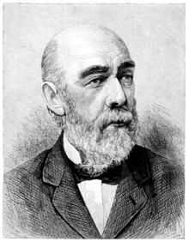
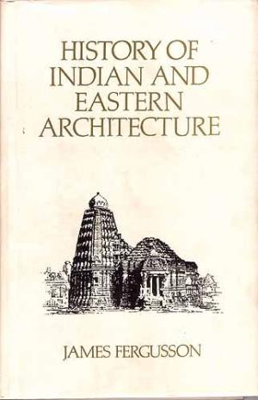
James Fergusson (1808 - 1886)
1876
Notes:
Fergusson’s work created a colonial framework for studying architectural history of the Subcontinent. Between 1855 and 1876…Fergusson’s work established the canon in South Asian architecture and became a standard for years to come.
Born in Scotland, James Fergusson (1808-86) was the first author to write comprehensively on Indian architecture. He was a self-taught “architectural historian.” He spent ten years as an indigo planter in India before embarking upon a second career as an architectural historian. His illustrated History of Indian and Eastern Architecture was first published in 1876 and set a colonial framework for studying the architecture of the Subcontinent.
It was revised in a two-volume edition of 1910 by James Burgess (1832-1916), former Director of the Archaeological Survey of India, and Richard Spiers (1838-1916), a noted architect and historian of architecture.
Fergusson presented a lecture to the Society of Arts in 1866. In this lecture he claimed that Indian architecture could be read like “a great stone book, in which each tribe and race has written its annals and recorded its faith.”
Fergusson, On the Study of Indian Architecture (London: Department of Science and Art, South Kensington Museum, 1867)

Slide 7
James Fergusson
“Between 1829 and 1847, James Fergusson looked into the architecture of the subcontinent and published the first illustrated history of Indian architecture, History of Indian and Eastern Architecture (1876).”
“Fergusson was an indigo planter who had amassed a considerable fortune. He had never seen many of the buildings he wrote about but based his writing on photographs and writings of others.”
James Fergusson (1808 - 1886)
Notes:
“Between 1829 and 1847, James Fergusson looked into the architecture of the subcontinent and published the first illustrated history of Indian architecture, History of Indian and Eastern Architecture (1876).”
“Fergusson was an indigo planter who had amassed a considerable fortune. He had never seen many of the buildings he wrote about but based his writing on photographs and writings of others.”
“Between 1855 and 1876 he published four editions of his book, each further expanded than the preceding volume. Fergusson’s work established the canon in South Asian architecture and remained the definitive source for years to come.”
“Fergusson’s choice of buildings, framework, and approach remain central to the teaching of South Asian architectural history.”
Source: Jyoti Hosagrahar, “South Asia: Looking Back, Moving Ahead—History and Modernization,” Journal of the Society of Architectural Historians, Vol. 61, No. 3 (Sept. 2002).

Slide 8
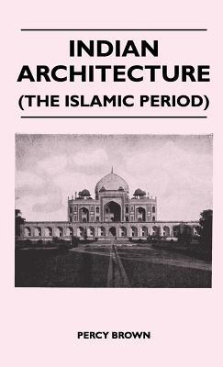
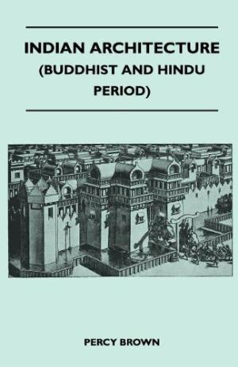
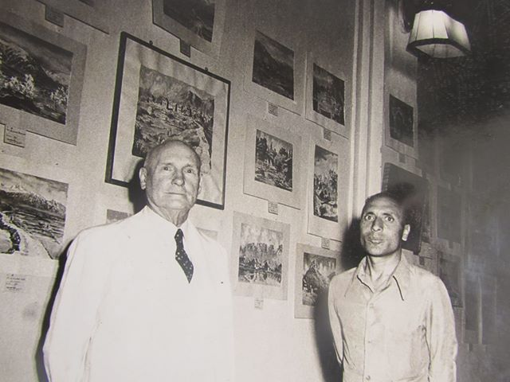
Percy Brown
(1872-1955)
Published in 1942
Notes:
Percy Brown (1872–1955) was a British scholar, artist, art critic, historian and archaeologist. These books were published in 1942.
His work, along with Fergusson’s created the “canon” of Indian Architecture. Most notable are Fergusson’s History of Indian and Eastern Architecture, and these works by Brown.
Fergusson, James. History of Indian and Eastern Architecture. New York, Dodd, Mead & company, 1876.
Brown, Percy. Indian Architecture (Buddhist and Hindu Period). Bombay: D.B. Taraporevala, 1942.
Brown, Percy. Indian Architecture (Islamic Period). Bombay: D.B. Taraporevala, 1942.

Slide 9
Problems of Architectural Curriculum in British India
Not liberal arts education but rather vocational training
Notes:
Formation of the Asiatic Society in 1784

Slide 10
Nineteenth-Century British Position on Indian Art and Architecture
An Indian civilization in decline
Scientific study must be undertaken
Documentation of historic antiquity was urgently needed
Preservation of historical antiquity is urgently needed to save a declining culture; superior colonialism knowledge and expertise enables historic preservation
The hypothesis of “racial inferiority” framed the study of architectural works
Notes:
Fodder for this new canonical view of Indian Architecture was the British point of view, in regard to Indian civilization being in decline, and therefore a site for scientific study.
In estimated danger of decline, the British felt that documentation of historic antiquity was urgently needed preservation of historical antiquity was urgently needed to save a declining culture. The British were armed with their superiority, in all things, including colonial knowledge of India, rendering them experts in historic preservation.
This superiority directly informed a hypothesis of “racial inferiority” that framed the study of architectural works.

Slide 11
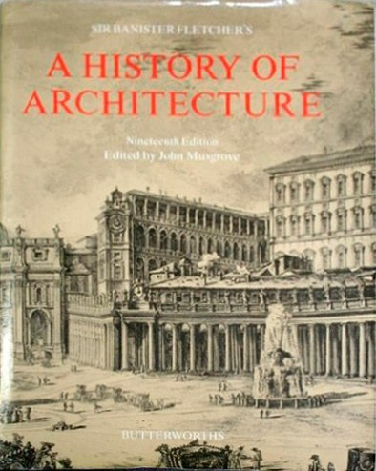
One of the standard text books in colonial India….
Published in 1894
Notes:
One of the standard text books in colonial India
Sir Banister Flight Fletcher (1866 - 1953) was an English architect and architectural historian. His father, also an architect and architectural historian, was too called Banister Fletcher.
The father-son team co-wrote the first edition of A History of Architecture on the Comparative Method (1894). This book became a standard reference work. It was revised and updated throughout the 20th century.
The book was praised for offering a robustly illustrated history of “world architecture” and for its “antiquarian” values. In many ways, the book became a “veritable student's bible” across architectural schools in the Subcontinent, at least until the 1980s. Even today many schools use this book as the main architectural history textbook.
Yet, many considered the book’s underlying epistemological premise deeply embedded in Eurocentric worldviews and the attendant assumptions of racial hierarchies. From the 1990s, Banister Fletcher’s book drew much postcolonial criticisms. A number of insightful articles were published that analyzed what they called epistemological problems in the book’s historiographic methodologies.

Slide 12
Bannister Fletcher’s Politics of “History”
“During [the] long period architectural styles, by the test of evolution, fall naturally into two groups, viz. the Historical Styles, which, beginning in Egypt and Assyria, reached their highest development in Europe, and the Non-Historical Styles of Indian, Chinese, Japanese, Ancient American, and Saracenic architecture, which were independent of and exercised little influence on the main stream of architectural development.”
Bannister Fletcher, A History of Architecture, 3.
Notes:
“Historical Styles” vs “Non-Historical Styles”
“During [the] long period architectural styles, by the test of evolution, fall naturally into two groups, viz. the Historical Styles, which, beginning in Egypt and Assyria, reached their highest development in Europe, and the Non-Historical Styles of Indian, Chinese, Japanese, Ancient American, and Saracenic architecture, which were independent of and exercised little influence on the main stream of architectural development.”
Bannister Fletcher, A History of Architecture, 3.

Slide 13
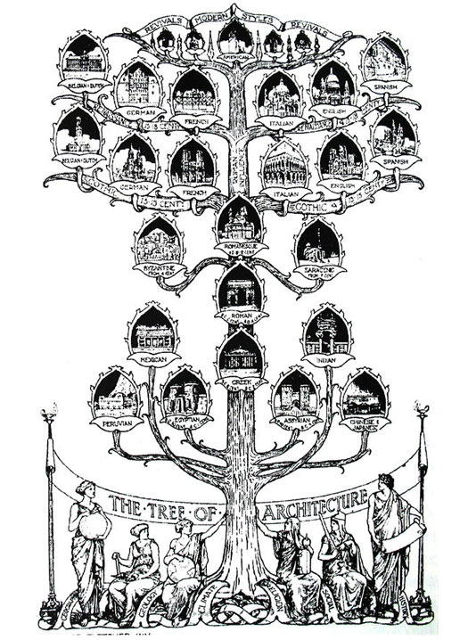
Notes:
Historical and Non-Historical in Banister Fletcher’s “Tree of Architecture.”
Based on a Hegelian model of teleology (telos means end), Fletcher’s “Tree of Architecture” sought to demonstrate the evolution of architecture toward a final perfect condition.
Image source: Fletcher, Banister. A History of Architecture on the Comparative Method for the Student, Craftsman, and Amateur. New York: Charles Scribner’s Sons, 1956.

Slide 14
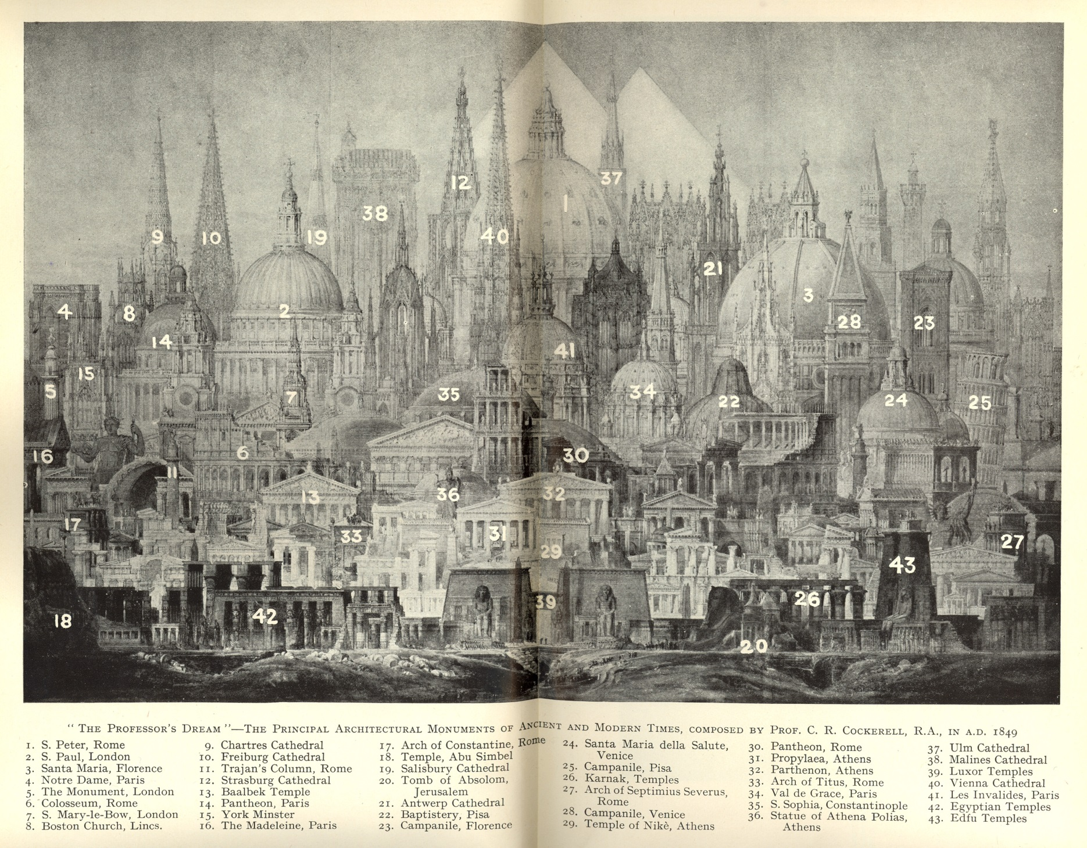
The bias toward “monuments”
Notes:
The bias toward “monuments” in Banister Fletcher’s “world history.”
Canonical histories, such as Banister Fletcher’s, are predominantly monument centric. In other words, the entire range of historical eras are seen and examined through the lens of monuments and spectacular buildings. Architecture of “everyday life”, vernacular and traditional buildings (even though what tradition and vernacular mean have given rise to a host of contentious debates) has been ignored.
Revisionist histories in recent times have made concerted effort to be more inclusive.
Original Image source: “The Professor’s Dream” – The principal architectural monuments of ancient and modern times, composed by Prof. C. R. Cockerell, R,A, in A.D. 1849

Slide 15
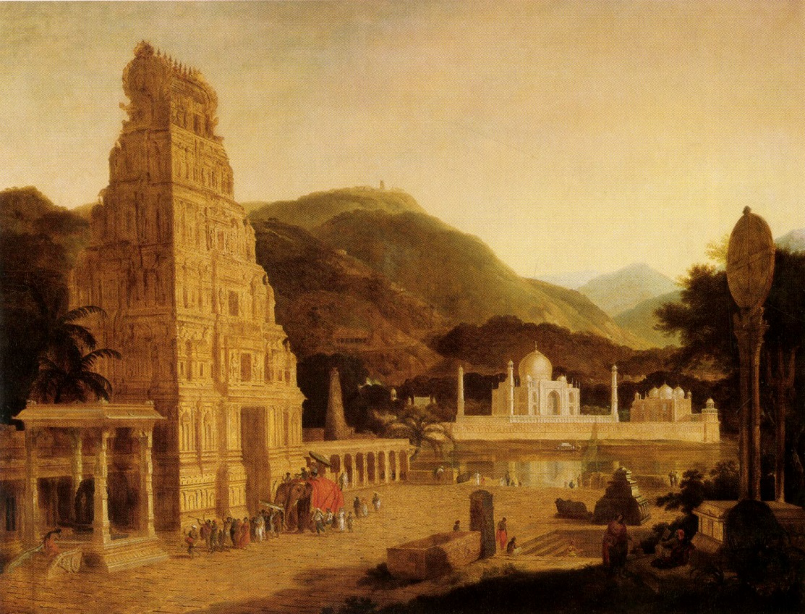
Thomas Daniell,
Composition:
Hindu and Moslem Architecture,
1799
Notes:
History as a sort of “fantasy” screen!
Travelogues and travel paintings by Englishmen during the colonial period created a rich tapestry of colonial perceptions of India.
Thomas Daniell, Composition: Hindu and Moslem Architecture, 1799, Oil Painting.
Source: Kopf, David. British Orientalism and the Bengal Renaissance: The Dynamics of Indian Modernization. Berkeley: University of California Press, 1969.

Slide 16
The Advent of “Revisionist” Histories from the 1980s Onward

Slide 17
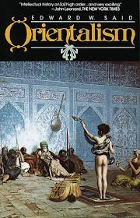
Notes:
Edward Said’s Orientalism (published in 1978) had a far-reaching, multidisciplinary influence on the Humanities studies, including art and architectural histories. The controversial and celebrated book sought to explain how Europe defined itself in opposition to the non-European cultures and peoples and how the non-Western world was reproduced in Europe’s imagination as static and inferior.

Slide 18
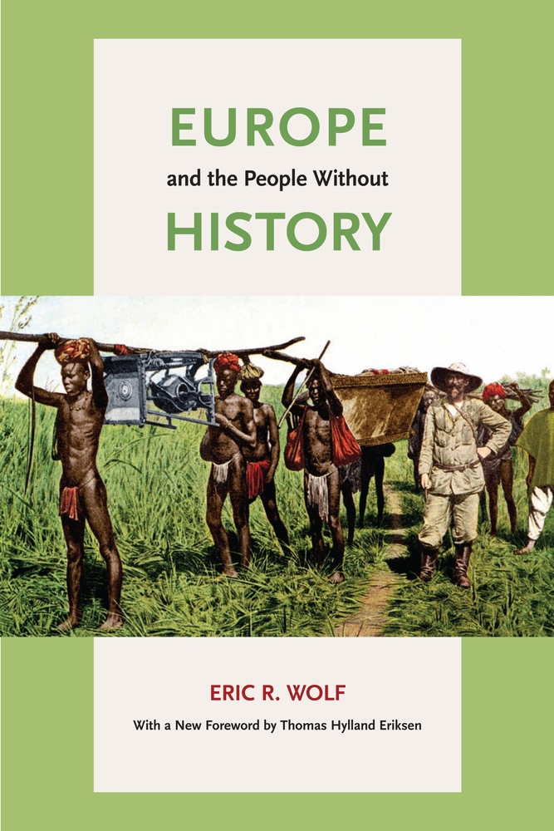
Notes:
Wolf, Eric R. Europe and the People without History. Berkeley: University of California Press, 1982.
Explaining such rhetorical social categories as "civilized" and "uncivilized", Europe and the People Without History questions the long-held anthropological notion that non-European cultures and peoples were closed and static societies (example: Fletcher’s characterization of “non-historical styles”) before the advent of European colonialism and imperialism.
Wolf challenges the implicit assumption that European history is the benchmark against which the achievements and experiences of other societies and peoples should be measured.
This type of critiques led to a new historiographic interest in the architectures of “peripheries”: non-western, traditional, vernacular, “architecture without architects,” etc.

Slide 19
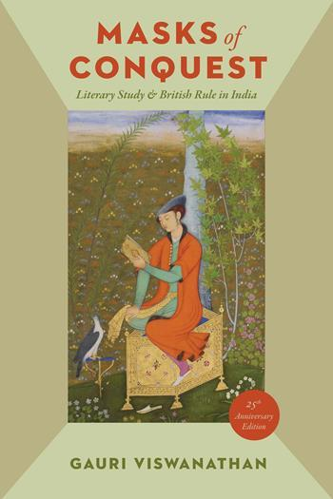
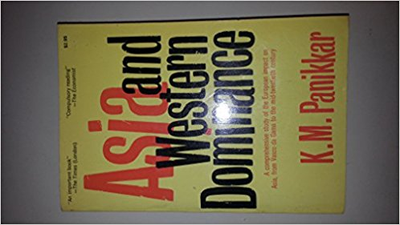
Notes:
An influence on Edward Said, K. M. Panikkar was Prime Minister Nehru’s first ambassador to China. His book explains the Western nation’s domination of Asia, beginning with the arrival of the Portuguese sailor Vasco da Gama landed at Calicut on the southwest coast of India. He calls it the
Vasco da Gama epoch. This period is then divided into four chapters: The Age of Expansion (1498-1750), The Age of Conquest (1750-1858), The Age of Empire (1858-1914), and Europe in Retreat (1918-1939).
“The genius of literature ... clearly sees ... that she has found the men who are to
extend her empire to the ends of the earth, and give her throne a stability that will
be lasting as the sun.”
-Madras Christian Instructor and Missionary Record (1844).
Gauri Viswanathan’s Masks of Conquests (1990) unpacks the complex and intimate relationship between imperialism and culture, knowledge and power. She explains how “soft” knowledge like literature enables colonial domination.
In Masks of Conquest, Gauri Viswanathan writes:
“The emergence of the discipline of English in colonial India, its rootedness in strategies of sociopolitical control, opens up fresh
inquiry into possible implications of empire for current debates on curriculum in general. When, in our own times, students and faculty clamor for a broadening of curriculum to include submerged texts of minority and third world cultures, the knowledge that the discipline of English developed in colonial times would appear likely to strengthen their claims and force their opponents to reconsider the premises of thetraditional Eurocentric curriculum. And to an extent a major objective of this book has been to point the direction to reconceptualizations ofcurriculum along these lines, for it should be amply clear by now that the Eurocentric literary curriculum of the nineteenth century was less a statement of the superiority of the Western tradition than a vital, active instrument of Western hegemony in concert with commercial expansionism and military action.”

Slide 20
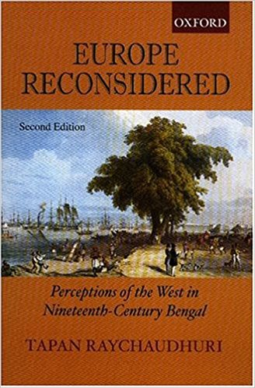
The argument of this book (published in 2002) helps demythologize the binary opposition between colonial powers and colonized societies. It is more like a chemical chain reaction with all kinds of unexpected developments.
Notes:
The argument of this book (published in 2002) helps demythologize the binary opposition between colonial powers and colonized societies. According to Tapan Raychaudhury, the relationship between colonizer and colonized is more like a chemical chain reaction with all kinds of unexpected developments and omnidirectional flow of knowledge.
One reviewer of the book wrote:
“During the late nineteenth century, Tapan Raychaudhuri argues, Bengali intellectuals began to take a second look at Europe. The earlier adulation of Bengal's English-educated middle class for every thing European was replaced by a new-found skepticism about Western claims to global superiority. Coupled with an attempt to forge an indigenous identity based on the regeneration of
Indian ways of life, this newly critical attitude towards Europe represented an attempt by India's intellectuals to negotiate a complex but positive form of Indian identity b tween pre-colonial Indian and colonial rule.”

Slide 21
A few key questions raised with regards to architectural survey courses in professional architectural schools
How does one write architectural histories that minimize the problems of Eurocentrism, while not diminishing differences between cultural practices?
How to write histories without a Eurocentric teleology?
How could one be inclusive of different building practices and at the same time demonstrate their interrelationship through a global network of trading routes, cultural exchanges, military conquest, pilgrimage routes, etc.?
Notes:
A few key questions raised with regards to architectural survey courses in professional architectural schools
How does one write architectural histories that minimize the problems of Eurocentrism, while not diminishing differences between cultural practices?
How to write histories without a Eurocentric teleology?
How could one be inclusive of different building practices and at the same time demonstrate their interrelationship through a global network of trading routes, cultural exchanges, military conquest, pilgrimage routes, etc.?
See Bozdogan, Sibel. “Architectural History in Professional Education: Reflections on Postcolonial Challenges to the Modern Survey,” Journal of Architectural Education, Vol. 52, No. 4 (May, 1999), pp. 207-215.

Slide 22
Intellectual Responses to the historiographic problems of Eurocentrism in architectural history survey books

Slide 23
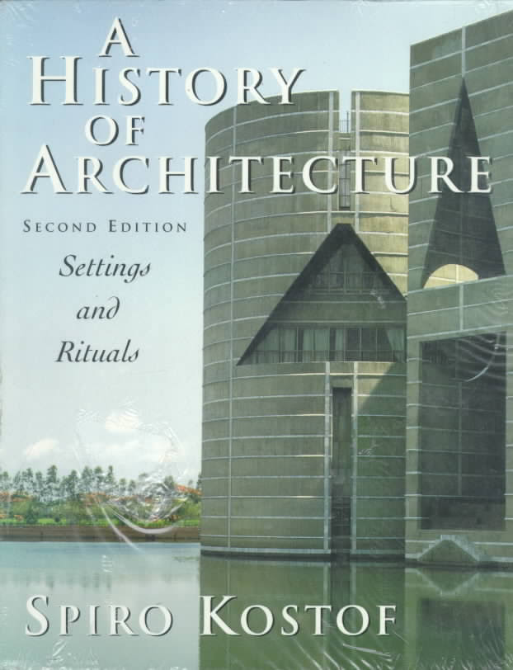
Notes:
Panayiota Pyla, “Historicizing Pedagogy: A Critique of Kostof's "A History of Architecture,"
Journal of Architectural Education, Vol. 52, No. 4 (May, 1999), pp. 216-225.
Kostof wrote in the book: "In our general scheme of things, [nonwestern] traditions have always held a secondary place. This is natural given the preoccupation of each culture with itself. But it becomes reprehensible if the relative inattention to nonwestern achievement is justified in general worthiness-the mentality that says: If it is not well known, it is because it does not deserve to be.“
Pani Pyla observed in Kostof’s historiographic methodology an honest comparative model of study:
“Although Kostof attempts to transcend traditional distinctions [of Western and non-Western] by declaring that the history of "other cultures" is important to understanding the history of "our" architecture, what escapes him is that the distinctions between other architectural traditions and ours may not be as "natural" as he thinks. Kostof's theory should not deflect attention from the methods of his historical practices, which are in essence synchronic cross-cultural comparisons.”
Kostof wrote: “Our esteem for Chartres Cathedral will be more balanced if we were made aware that this masterpiece of medieval Christianity rose during the same decades in which Indochina saw the specter of the great temple complex at Angkor Wat, the empire of Islam undertook the mosque and mausoleum of Sultan Qala’un in Cairo, and the great Seljuk caravanserais of Anatolia.”
But, as Pyla demonstrates in her article (cited above), Kostof looks at non-Western architecture through a western historiographic lens, in which Pantheon becomes an expression of Roman grandeur in a particular temporal context of Roman history, while Islamic souks are examples of historically frozen “timeless” architecture. In short, Fletcher’s ghost still lurks behind Kostof’s cosmopolitan historiography.

Slide 24
Architecture of
Ancient Egypt
Mesopotamia
Greece
Rome
Middle Ages
Renaissance
Modernism
NOT GLOBAL HISTORY
Notes:
One of the critiques of the so-called revisionist histories was that while they endeavored to include much left-out historical content of non-Western territories, these history surveys were still continuing the same compartmentalized histories with an aura of inclusion.

Slide 25
Architecture of
Ancient Egypt
Greece
Rome
Middle Ages
Renaissance
Modernism
+
China
India
Asia
Japan
Nigeria
Etc.
Notes:
One of the critiques of the so-called revisionist histories was that while they endeavored to include previously ignored historical contents of non-Western architectures, these history surveys were still continuing the same compartmentalized histories, only with an aura of inclusion.

Slide 26
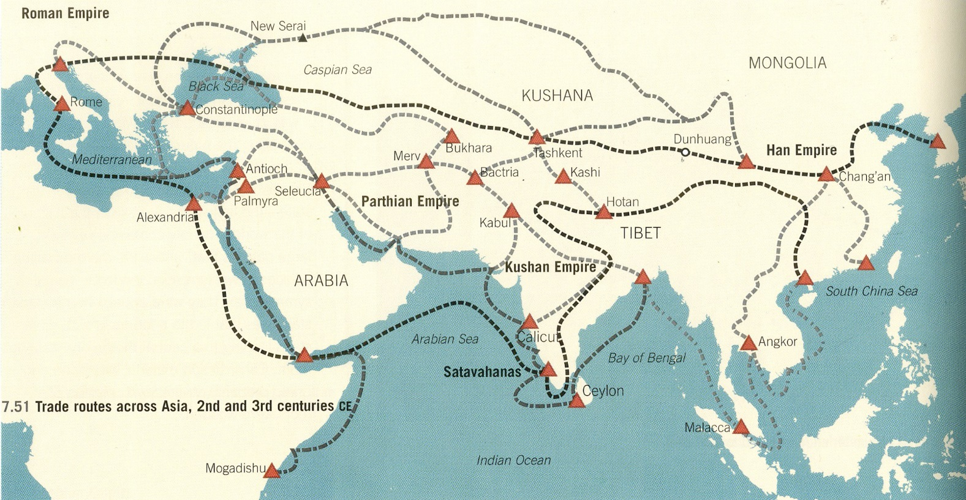
Notes:
The Indian subcontinent was connected with trading routes between the eastern most shores of China and the Mediterranean world and beyond. The network of trading routes, pilgrimage movements, military conquests, and maritime economy made the subcontinent an integral part of Eurasian and Chinese economies and spheres of influence. Standard architectural histories of the subcontinent have not examined the network of connections that made the Indian subcontinent as part of a broader economic systems.
Image source: Ching, Francis D.K., Mark Jarzombek, and Vikramaditya Prakash. A Global History of Architecture. New Jersey: John Wiley & Sons, 2011. p. 214.

Slide 27
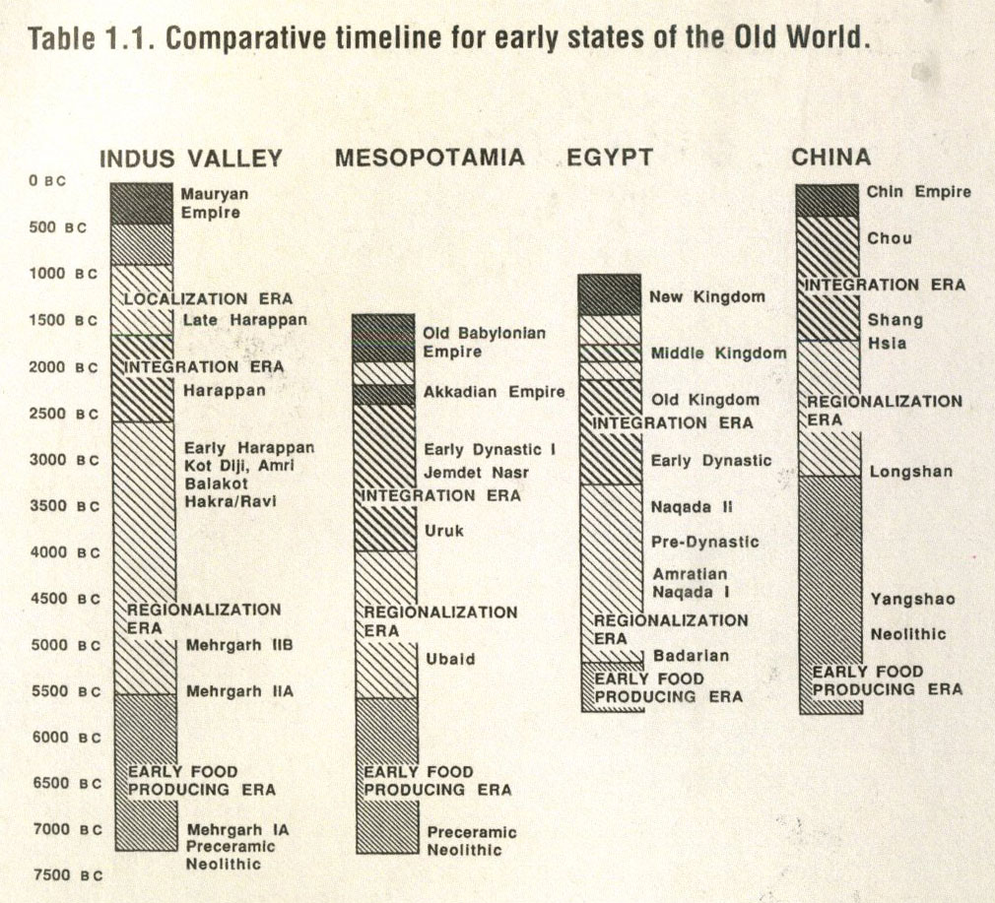
Notes:
Canonical architectural history survey textbooks generally ignored the interdependent networks of trading and other kinds of human movements across territories as catalysts for architectural production and building activities.
For example, the Indus civilization formed part of an interconnected zone that extended across western Asia and even into Egypt. Ships carried bricks, beads, lumber metals, and lapis lazuli up the Persian Gulf to the cities of Mesopotamia. Initially, most of the trade across this zone was by land routes. But around 2700 BCE, the exploitation of the coastal routes of the Persian Gulf multiplied the wealth of the entire zone.
Image Source: Kenoyer, J. Ancient Cities of the Indus Valley Civilization. Oxford University Press, 1998.

Slide 28
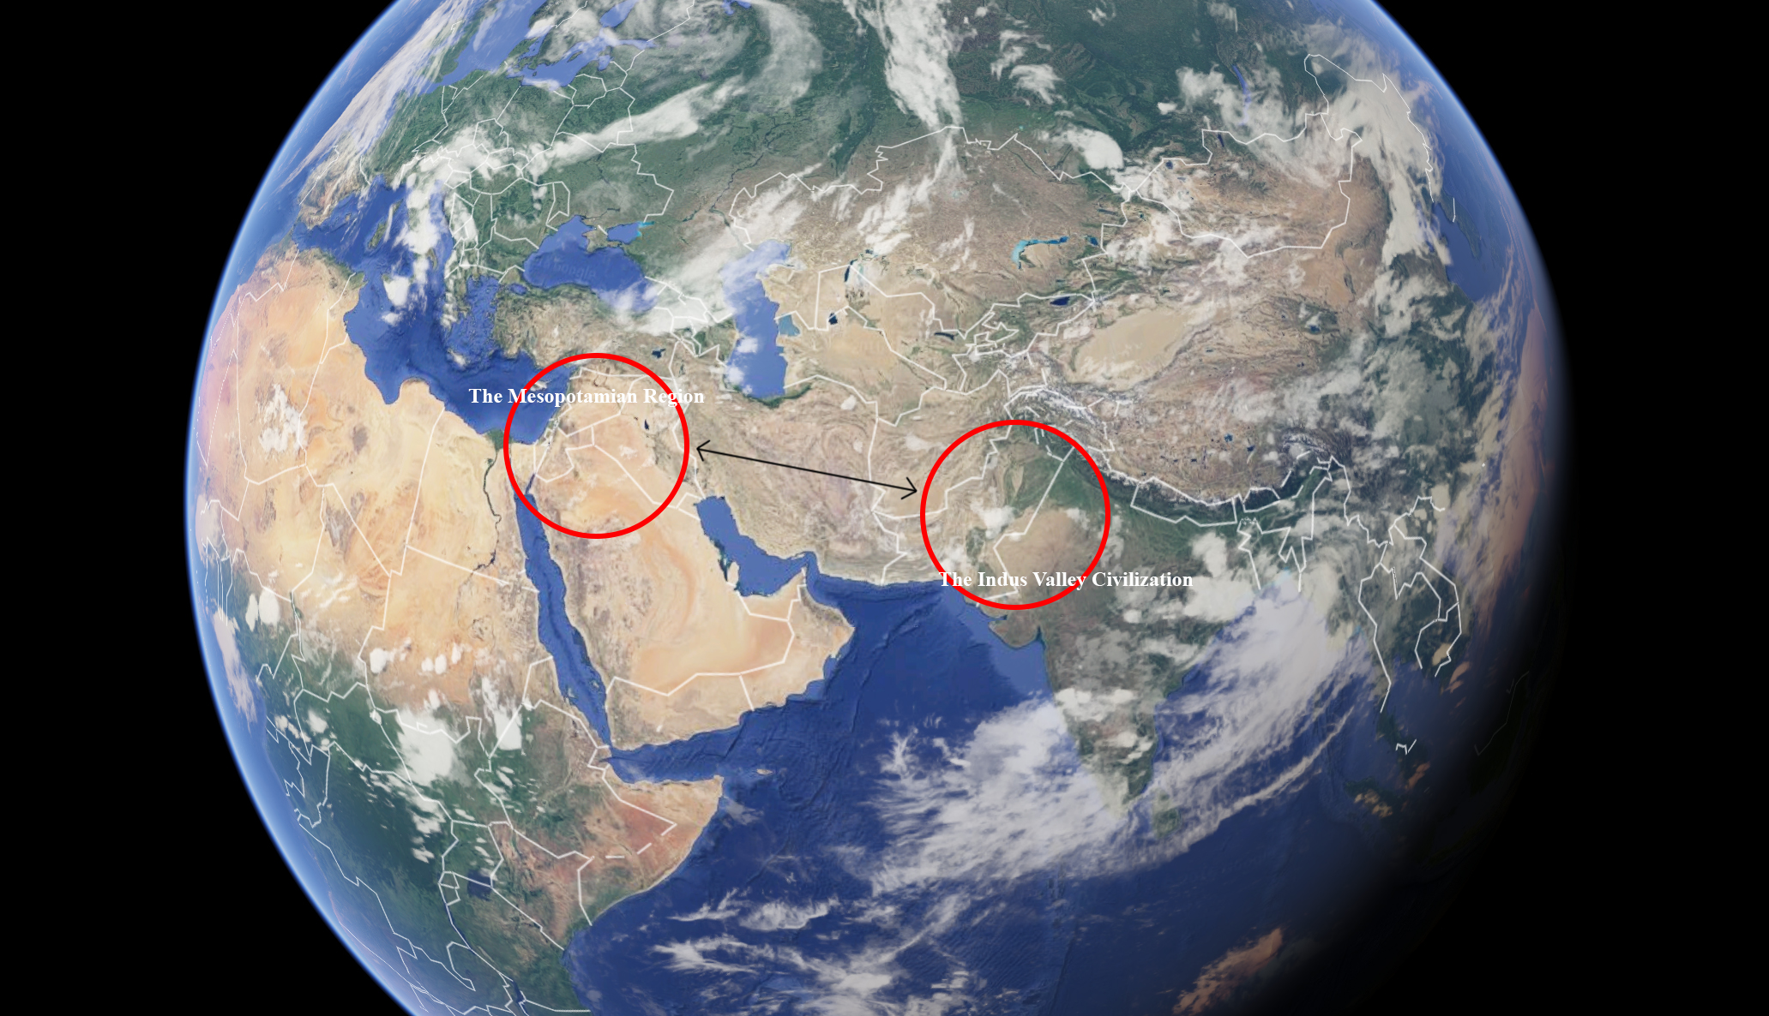
Notes:
Trade routes from the Indus Valley to Mesopotamia
The Indus civilization formed part of an interconnected zone that extended across western Asia and even into Egypt and Crete. Ships carried bricks, beads, lumber metals, and lapis lazuli up the Persian Gulf to the cities of Mesopotamia. Initially, most of the trade across this zone was by land routes. But around 2700 BCE, the exploitation of the coastal routes of the Persian Gulf multiplied the wealth of the entire zone.
Image source: Google Earth prepared by Anh-Tu Nguyen and Kelly Foley, Catholic University of America

Slide 29
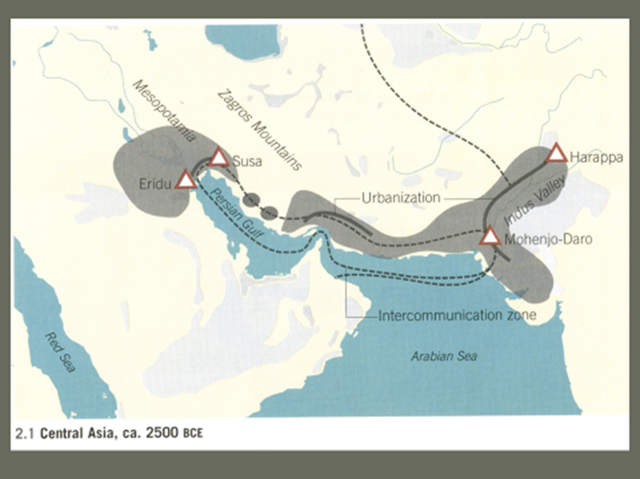
Trade routes from the Indus Valley to Mesopotamia
Notes:
Trade routes from the Indus Valley to Mesopotamia
The Indus cities entered a mature phase of urbanization around 2600 BCE.
The Indus civilization formed part of an interconnected zone that extended across western Asia and even into Egypt and Crete. Ships carried bricks, beads, lumber metals, and lapis lazuli up the Persian Gulf to the cities of Mesopotamia. Initially, most of the trade across this zone was by land routes. But around 2700 BCE, the exploitation of the coastal routes of the Persian Gulf multiplied the wealth of the entire zone.
Image source: Ching, Francis D.K., Mark Jarzombek, and Vikramaditya Prakash. A Global History of Architecture. New Jersey: John Wiley & Sons, 2011.

Slide 30
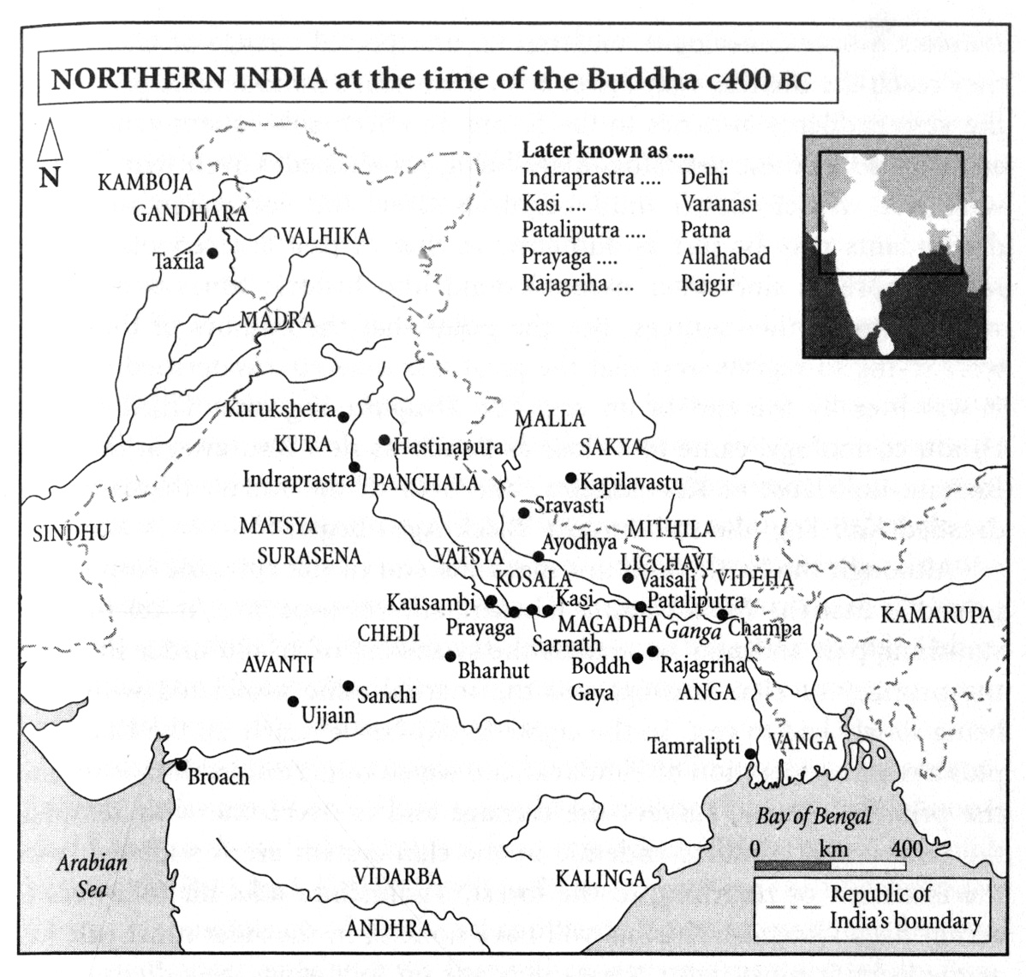
Notes:
Geography, Climate, Social Organization, Mobility, and Architecture: One of the key challenges in architectural histories is to consider multiple vectors in the construction of space and landscape.
Early Indian society, though settled and familiar with agriculture, was still clan-based. Kingship was subordinate to kinship and probably amounted to no more than chieftanship-among-equals. Eventually population pressures on land and other resources would encourage greater social specialization and the assertion of a central authority, two prerequisites of a state.
The Uttarapatha, the northern route of east-west transit and trade, extending from the Panjab to the lower Ganga, became as much the main axis of Aryanization as it would subsequently of Buddhist proselytization and even Magadhan imperialism. It was long the Uttarapatha that the Aryanised territories would first begin to assume the trappings of statehood.
Image source: Keay, John. India: A History. London: Harper Perennial, 2000. pg 45
Text souce: ibid, pg 39-43

Slide 31
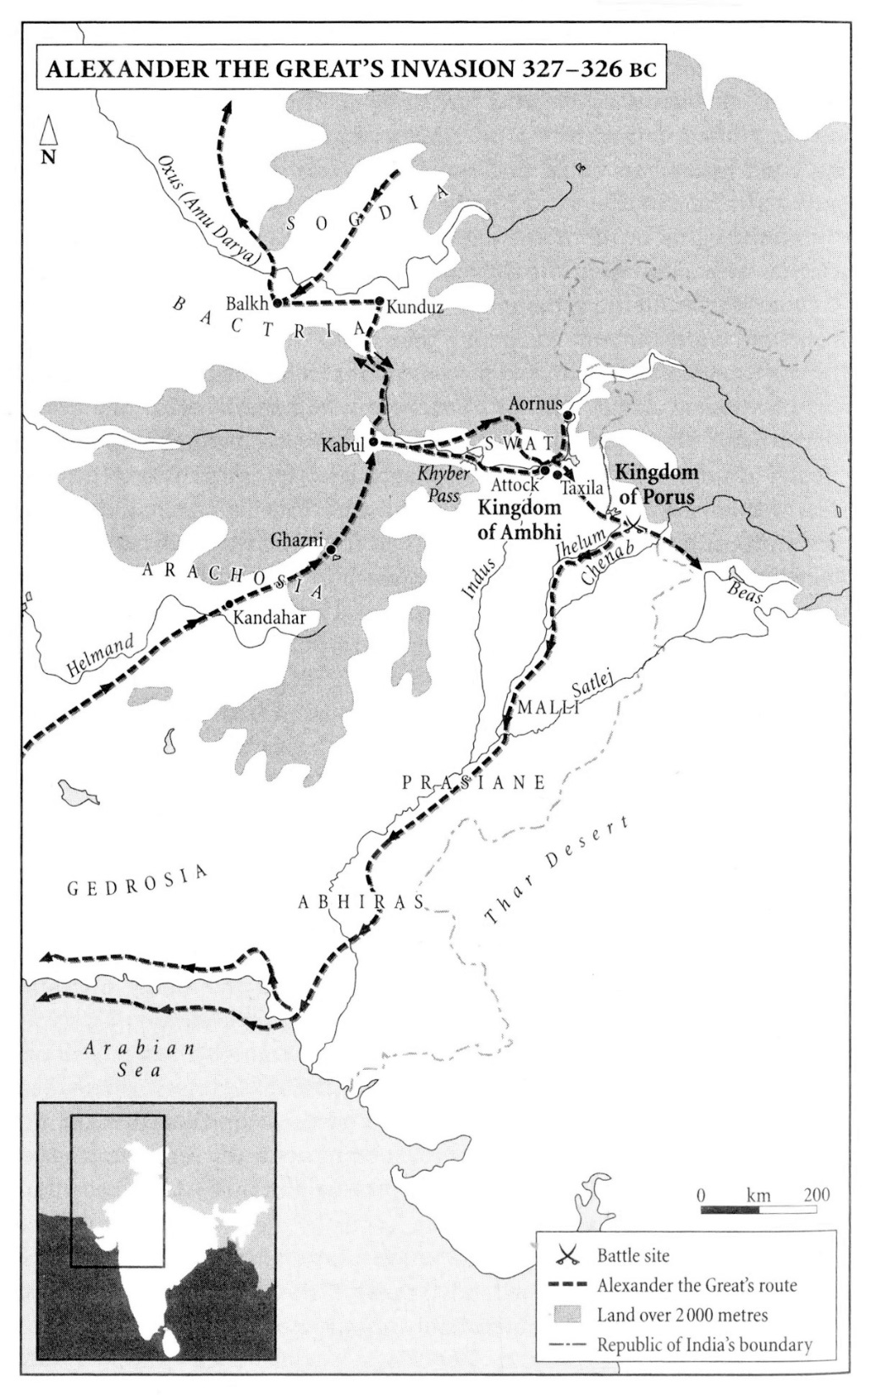
The fusion of cultures
Notes:
The fusion of cultures
Alexander’s great achievement was not invading India but getting there. A military expedition against the Achaemenid empire, originally planned by his father, become more like a geographical exploration as the men from Macedonia triumphantly probed regions hitherto undreamed of.
The Macedonians moved on, continuing east and south across the grain of the Panjab river system. They crossed the Chenab, then the Ravi. Countless ‘cities’ capitulated, others offered a short-lived resistance. They crossed what is now the frontier between Pakistan and India somewhere in the vicinity of Lahore. But his men were unimpressed. Alexander sensed a mood of mutiny. He had no choice but to announce a withdrawal. To round off his conquests, complete his explorations, and disguise his failure, Alexander opted to return by sailing down the Jhelum and the Indus to the ocean. Ships were readied and he sailed in late 326 BCE.
Image source: Keay, John. India: A History. London: Harper Perennial, 2000. p. 74
Text source: Ibid, p. 70-75.

Slide 32
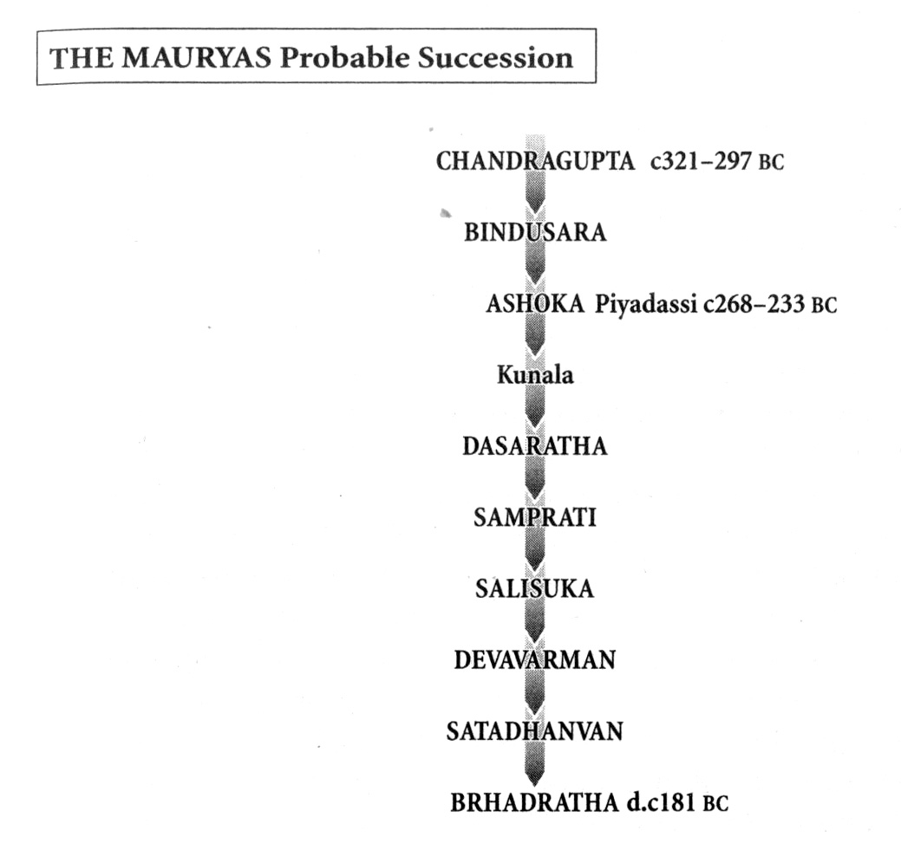
Early imperial hegemony
Notes:
Early imperial hegemony
The Mauryan empire was probably the most extensive ever forged by an Indian dynasty; even the Mughals rarely achieved a wider hegemony. It became the first to stretch from sea to sea – from the Bay of Bengal to the Arabian Sea. The object may not have been “to unite India”, more probably its westward expansion was intended to engross that lucrative maritime trade.
Between the death of Ashoka in 231 BCE. and the advent of Gupta power in 320 CE. India’s ancient history plummets again to a murky obscurity. The five hundred years between the Mauryas and the Guptas was called “India’s Dark Age”.
Image source: Keay, John. India: A History. London: Harper Perennial, 2000. pg 87
Text source: ibid, pg 93-94, 101

Slide 33
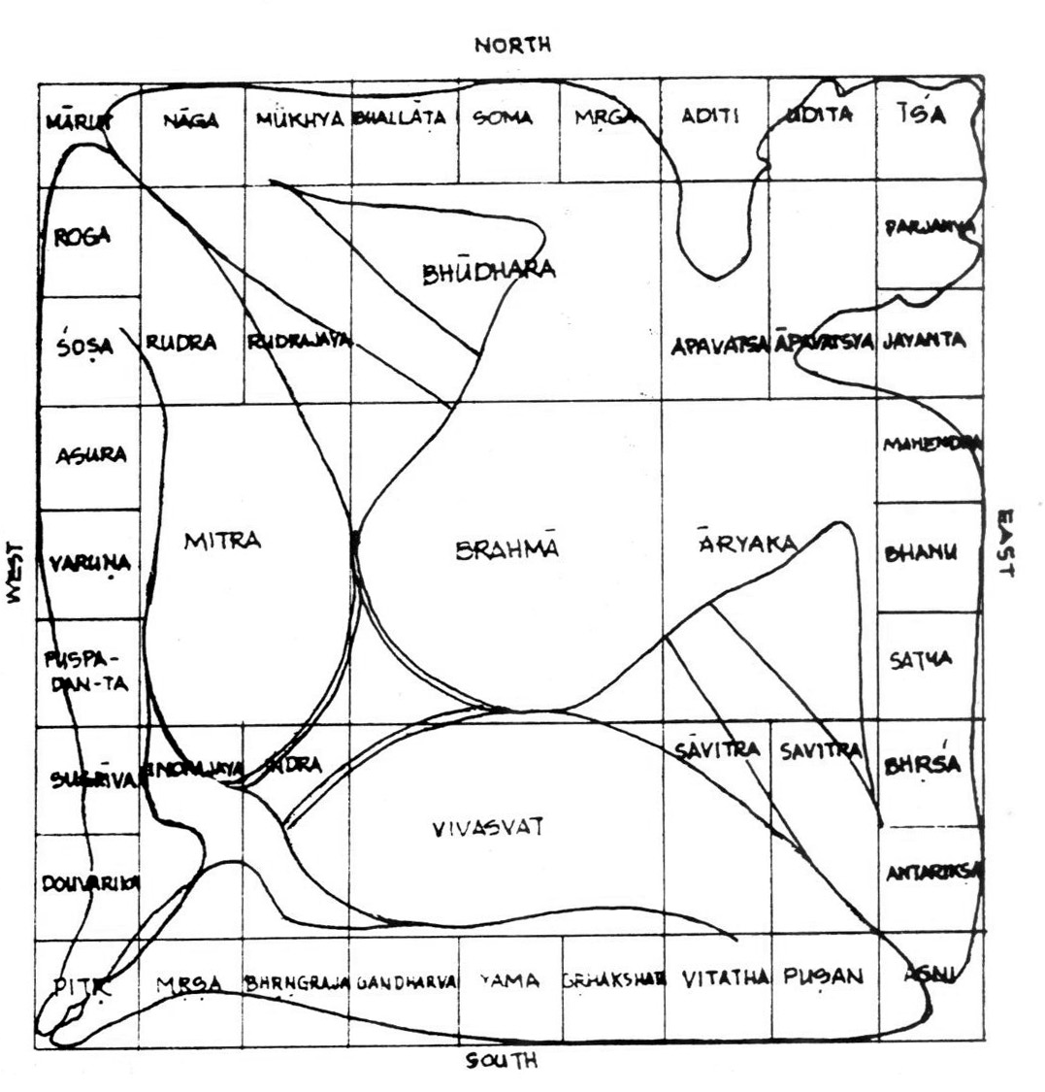
Ancient Architectural Theory
Notes:
Ancient Architectural “Theory”
Recent architectural history survey books include early Indian developments in architecture, town planning, and even hydrological achievements, but very little of ancient “architectural theory” that was used for siting a building or employed as a master plan for laying out a building.
Definition of Vastu Purusha Mandala: The Vastu Purusha Mandala is an indispensable part of vastu shastra and constitutes the mathematical and diagrammatic basis for generating design. It is the metaphysical plan of a building that supposedly incorporates the course of the heavenly bodies and supernatural forces.
Once the orientation of the Vastu Purusha Mandala is superimposed on the site. The Vastu Purusha Mandala can be regarded as the master grid for design. The Mandala is the grid in its ideal form of a square, and symbolizes the Purusha or the cosmic man who is pressed down on each of its subdivisions by various divinities. This has a symbolic, functional, as well as ritualistic bearing on the house.
Image Source: Chakrabarti, Vibhuti. Indian Architectural Theory: Contemporary Uses of Vastu Vidya. Curzon, 1998. p. 7.
Text source: ibid, pg. 5-6.

Slide 34
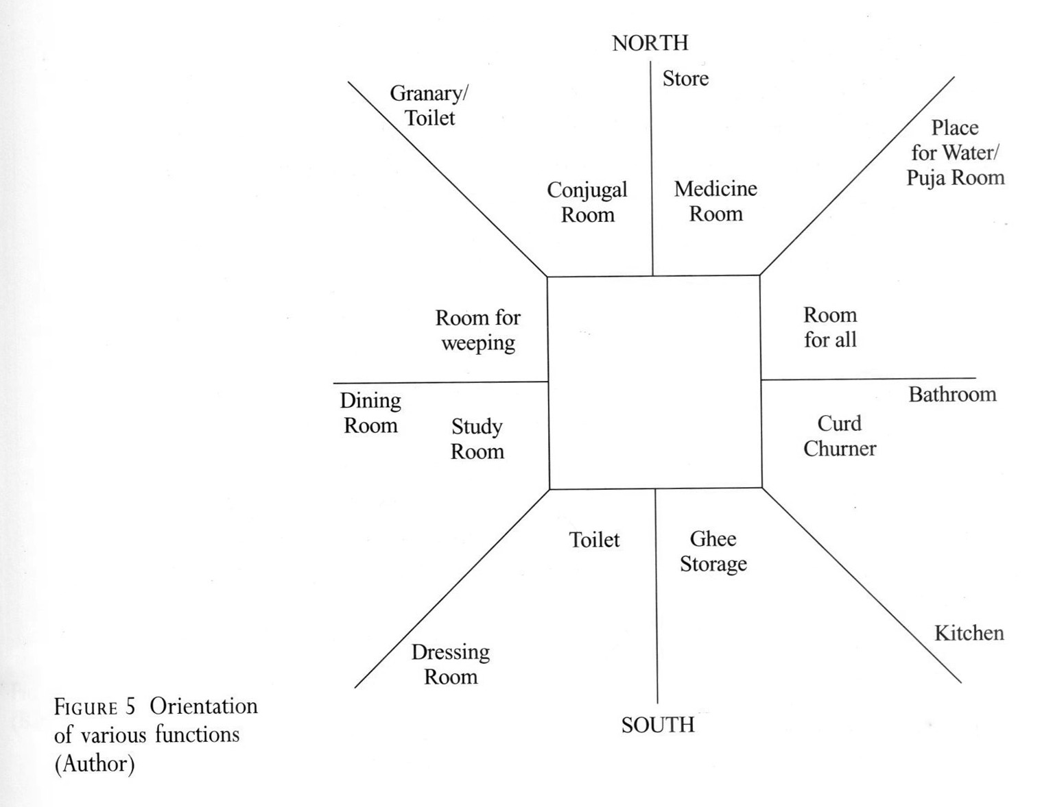
Notes:
Functional map derived from Vastu Purusha Mandala of 91 squares.
Image Source: Chakrabarti, Vibhuti. Indian Architectural Theory: Contemporary Uses of Vastu Vidya. Curzon, 1998. pg 7

Slide 35
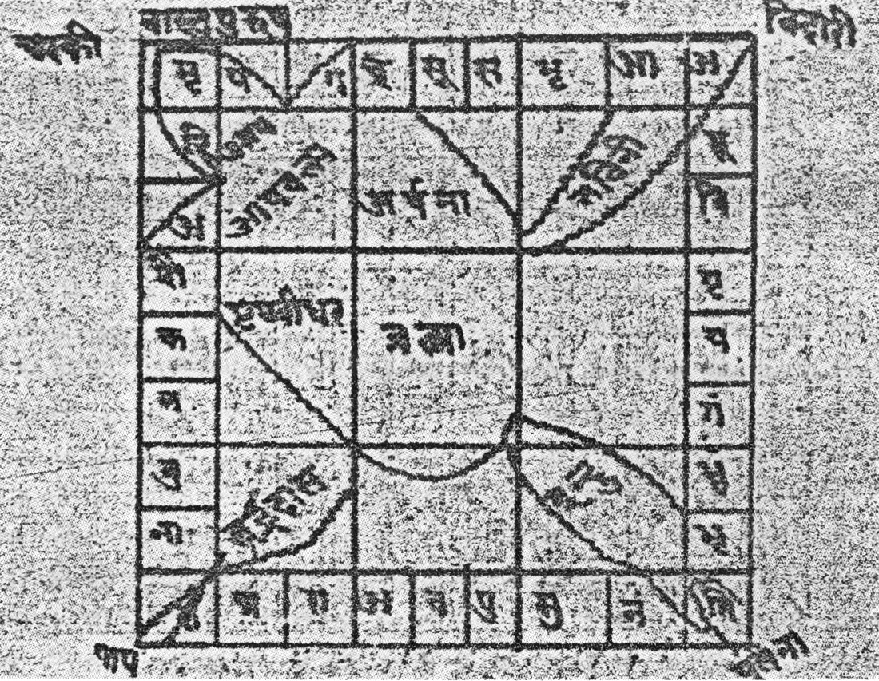
The graphic imagery of the Purusha (Rajavallabha, 1911)
Notes:
The divinities keep the body of the Purusha pressed to the ground. According to the mythology, the Purusha who possessed great strength and posed a threat of destruction, is contained by the Gods, who keep him pressed on the earth. The established association of the parts of the body of the Purusha to the divinities on the Mandala perform an architectural function. The correlation of the functions allocated to the various plots of the Mandala with the nature of the body-part of the Purusha provides a rough zonal map that is easy to reckon and implement. For example, the head is where a place of worship is located. The navel is left open to the sky symbolizing the supremacy of Brahma and also the vulnerability of the navel.
A flaw in any part of the house would result in an infliction to the corresponding body-part of the householder.
The comparative study of the Vastu Vidya texts reveals varying efforts towards defining the form of the Purusha to be reproduced graphically – to explain in exact terms of a drawing the position of the Purusha on the Mandala. From a complete absence of any graphic description of the Purusha on the Mandala, to its description as a “hump backed, crooked and lean” figure, and its description in terms of right and left eyes, ears, arms, legs, laterally positioned on two sides of the diagonal of the square, and finally to a speculation of the position of the head, feet, and the points of conjunction of the elbows and the knees in relation to the four corners of the square, in addition to the description of the position of the deities on the body parts – all this is a process leading to a certain kind of ionization of a functional attribute and principle.
Image Source: Chakrabarti, Vibhuti. Indian Architectural Theory: Contemporary Uses of Vastu Vidya. Curzon, 1998. pg 83
Text Source: ibid, pg 81-82

Slide 36
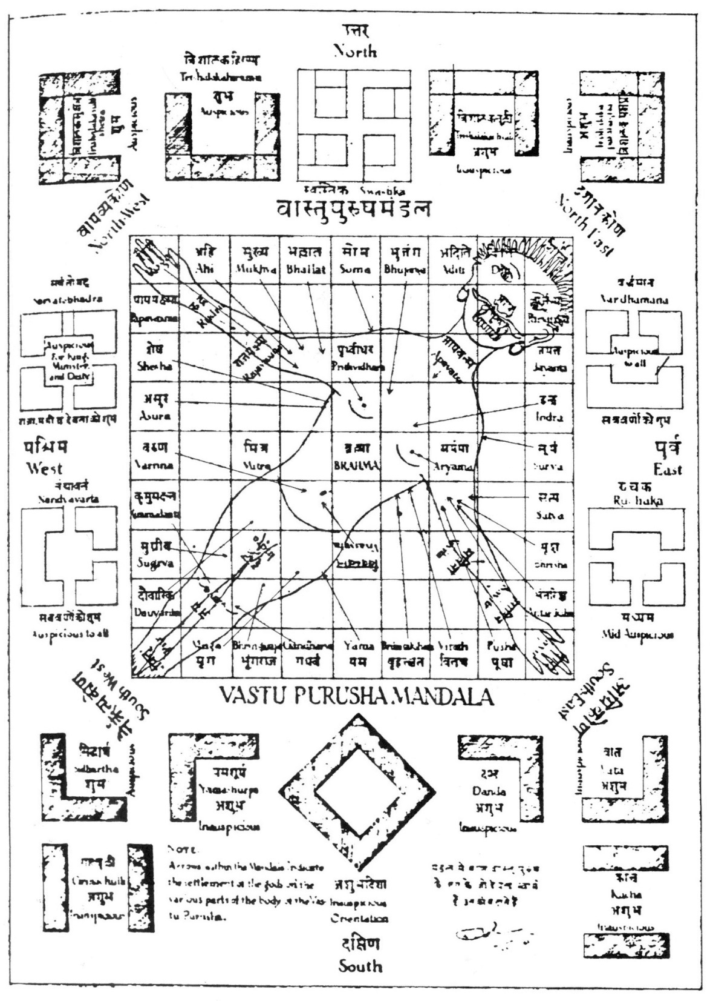
The graphic imagery of the Purusha (Dhama, 1962)
Notes:
Another interpretation of the Purusha on the Mandala descriptions from the Vastu Vidya texts.
Image Source: Chakrabarti, Vibhuti. Indian Architectural Theory: Contemporary Uses of Vastu Vidya. Curzon, 1998. pg 84

Slide 37
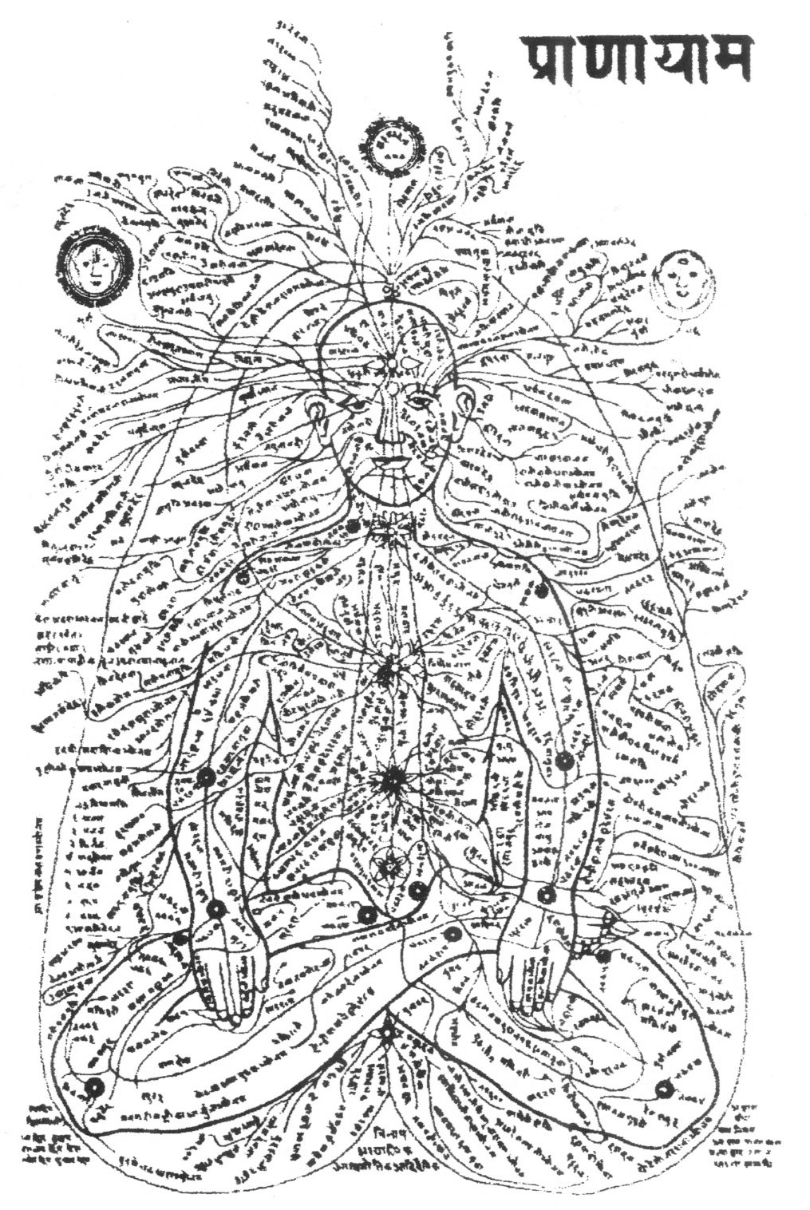
Energy channels of the subtle body (Tantra Foundation)
Notes:
In Indian thought, the cardinal directions hold a particular significance. Understanding the import of the directions leads on to analyzing the various associations that reveal the essential attribute the directions possess and manifest in the for of the exacting orientation prescription laid down by Vastu Vidya. The study of qualities revealed through Ayurveda (see image) at the microcosmic level of a human body, could be extended to understand its reflection in the intermediary sheath of man-made construct.
Image Source: Chakrabarti, Vibhuti. Indian Architectural Theory: Contemporary Uses of Vastu Vidya. Curzon, 1998. pg 103
Text Source: Same as text, pg 101

Slide 38
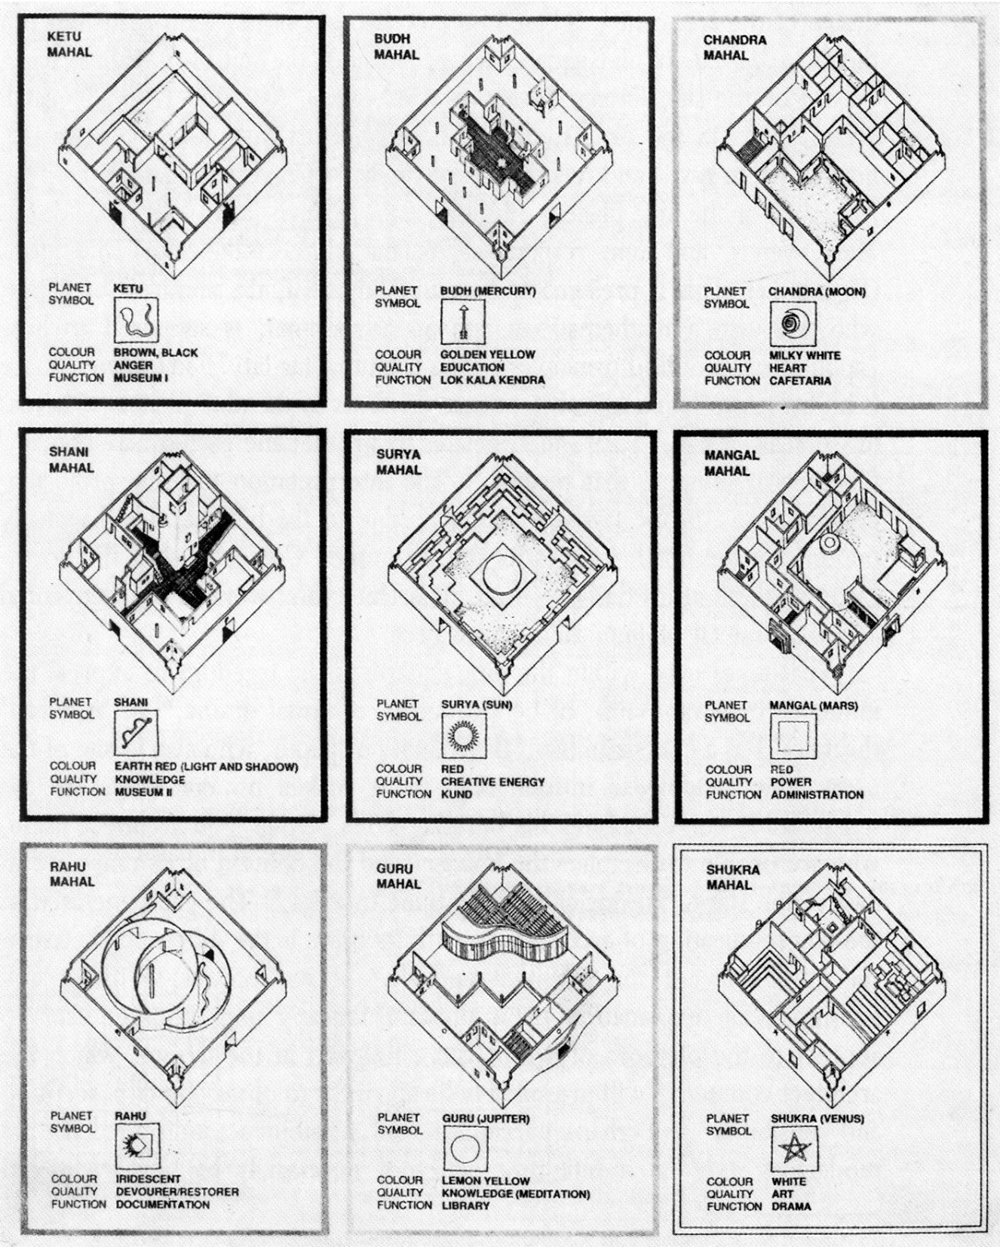
Modern architecture’s search for the “origin” and “authenticity”
The nine squares in the design of Jawahar Kala Kendra (A+D, 1991)
Notes:
Modern architecture’s search for the “origin” and “authenticity”
To the “modern” architect in search of his Indian identity, the Vastu Purusha Mandala seems to be the most popular solution that satisfies the urge to ‘root’ the building in tradition. The conscious evasion of the usage of the traditional motifs, expressing the strong dislike of visual pastiche, has lead to another kind of pastiche: the conceptual one. The underlying principles of the Vastu Purusha Mandala are as foreign to the Indian architect as the parameters of design and architectural appreciation he employs. Yet the esoteric complexity of Vastu Vidya has a ‘magical’ appeal that provides a convenient way to theoretically root the design in tradition, whilst also aborting its usage by limiting it to a grid, so that the visual label of ‘modernity’ could be retained.
One closely associated example of a contemporary building that draws upon the interpretation of Jaipur (that usage of the 9 squares of the Vastu Purusha Mandala is synonymous with rooting the design in tradition) is the Jawahar Kala Kendra designed by Charles Correa (1986). “Based on the vastupurusha mandala of the Vedic shastras where architecture is conceived as a model of the cosmos, the specific mandala invoked here is the navagraha consisting of nine squares.”… Correa’s Mandala has the Navagraha of the nine planets – Jupiter, Rahu, Saturn, Ketu, Mercury, Moon, Mars, Venus, and the Run, respectively in the plots…. “Each square relates to a planet and each square contains functions relating to that planet.” The interpretation that the projecting eastern square in the layout of Jaipur is due to the hill that lies diagonally opposite in the north-west of its site, prompted Correa to shift the north-eastern square in his design.
Image Source: Chakrabarti, Vibhuti. Indian Architectural Theory: Contemporary Uses of Vastu Vidya. Curzon, 1998. pg 90
Text source: ibid, pg 86-89

Slide 39
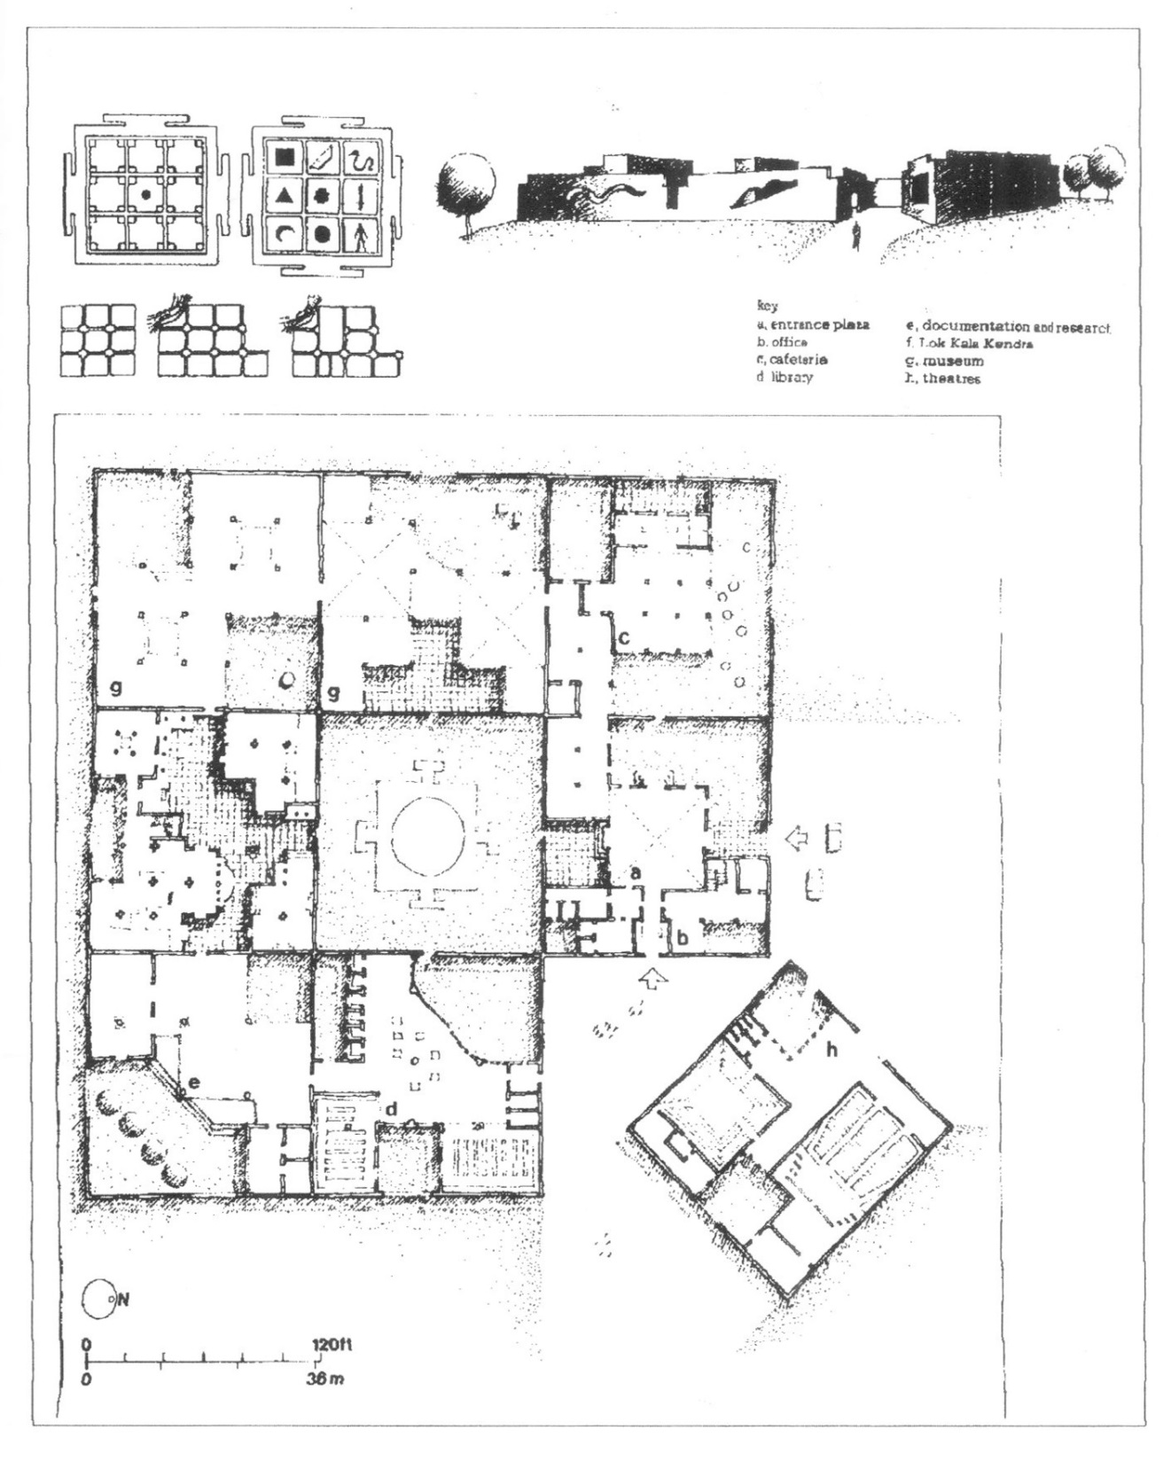
“Indigenous modernity?”
Charles Correa’s plan for the Jawahar Kala, Jaipur (1986)
Notes:
“Indigenous modernity”
One example of the reinvented literal translation is the Jawahar Kala Kendra in Jaipur, designed by Charles Correa (1986). It is based on a grid of nine squares, with each of the squares associated with functions derived from the given planetary associations. The Navagraha Mandala used for performing rituals, here adopts the role of a Vastu Purusha Mandala. The ‘Indian” architect today enjoys the freedom to borrow the symbols of the philosophy, and ‘process’ them as it were to present narratives of individualistic design statements.
Image Source: Chakrabarti, Vibhuti. Indian Architectural Theory: Contemporary Uses of Vastu Vidya. Curzon, 1998. pg 128

Slide 40
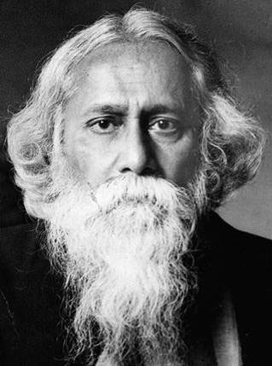
The Problem of defining “Modernity”
and “Nationalism”
The “Universal Humanity” of the Bengal Renaissance
Notes:
Bengal Renaissance refers largely to the social, cultural, psychological, and intellectual changes in Bengal during the nineteenth century, as a result of contact between certain sympathetic British officials and missionaries on the one hand, and the Hindu intelligentsia on the other. The setting for the Bengal Renaissance was the colonial metropolis of Calcutta.
Before 1830, earlier than any other Asian city, Calcutta already had a school system using European methods of instruction and textbooks. On their own initiative, the urban elite had founded Hindu College, the only European-style institution of higher learning in Asia. The city had a public library in European style. Calcutta also boasted a native intelligentsia conversant with events in Europe, aware of its own historical heritage, and progressively alert about its own future in the modern world.
The representatives of the British in India who were mainly responsible for these positive aspects of modernization were a group of "acculturated" civil, military, and judicial officials (and some missionaries) historiographically identified as Orientalists. They were neither nationalists nor imperialists in the late nineteenth-century Victorian sense. On the contrary, they were products of the eighteenth-century world of rationalism, classicism, and Enlightenment. Unlike later Europeans serving in British India, they mastered at least one Indian language and used it as a vehicle for scholarly research. Many Orientalists-notably William Jones, HT Colebrooke, William Carey. HH Wilson, and James Prinsep made significant contributions to the fields of Indian philology, archeology, and history. Moreover, these Orientalists did not ensconce themselves in clubs or build a Chinese wall of racial privilege to keep the" inferior races" they ruled at a distance. On the contrary, the Orientalists formed enduring relations with members of the Bengali intelligentsia to whom they served as sources for knowledge of the West and with whom they worked to promote social and cultural change.
Between 1800 and 1830, in Calcutta, as a consequence of the Orientalist impact, the Bangali intellectual was a confused but optimistic individual striving to reconcile partially digested alien traits and unsatisfactory indigenous traditions. He established relationships with British civil servants, businessmen, and missionaries both for profit and to use them as windows to the West. It was his good fortune that the distance between Britain and India was great and that the Orientalists with whom he associated had become "Indianized. The Bangali view of the West during the sympathetic Orientalist period helped to establish good rapport between Europeans and Indians offering hope for the future.
It should be noted that the movement known as the Bengal Renaissance, regardless of the good relationships established between the British and Indians and the accomplishments resulting from such interactions, the Bangali intellectual of the early 1800s was insecure psychologically. The renaissance vision was in its early stages often painful because of the contact and confrontation between two civilizations and the awareness of a newly discovered historical dimension. The Orientalists imparted to him their evocation of an Indian golden age while the Serampore missionaries transmitted a Protestant concept of the European medieval period as a dark age. Both inspired in the Bangali a belief in the perfectibility of the whole humanity. On the one hand, the intelligentsia regarded them as the product of an exhausted culture and on the other, as representatives of a culture disrupted by negative historical circumstances but capable of revitalization.
There were four aspects of the Renaissance movement, which the Bangali intelligentsia developed systematically throughout the nineteenth century. First, there was the modernization of the Bengali language and the simultaneous birth of a new Bangali literature. Secondly, there was the rediscovery of, and identification with an Indian classical era hailed as a golden age which placed South Asian civilization on a par with the grandeur of Greece and Rome. Thirdly, there was the Serampore missionary interpretation of the Protestation Reformation, which Indians applied creatively to their own historic situation. And finally, there was the secular view of universal progress on which India's hope lay not in resurrecting the past but in projecting the golden age into the future.
Reference: http://en.banglapedia.org/index.php?title=Bengal_Renaissance
The poet Rabindranath Tagore was one of the last intellectual pillars of the Bengal Renaissance.
Rabindranath Tagore (1861 - 1941) was a Bengali poet, short-story writer, song composer, playwright, essayist, and painter who introduced new prose and verse forms and the use of colloquial language into Bengali literature, thereby freeing it from traditional models based on classical Sanskrit. He was highly influential in introducing Indian culture to the West and vice versa, and he is generally regarded as the outstanding creative artist of early 20th-century India. In 1913 he became the first non-European to receive the Nobel Prize for Literature. https://www.britannica.com/biography/Rabindranath-Tagore

Slide 41
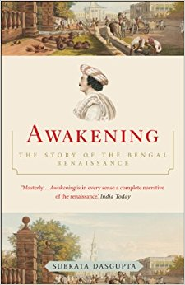
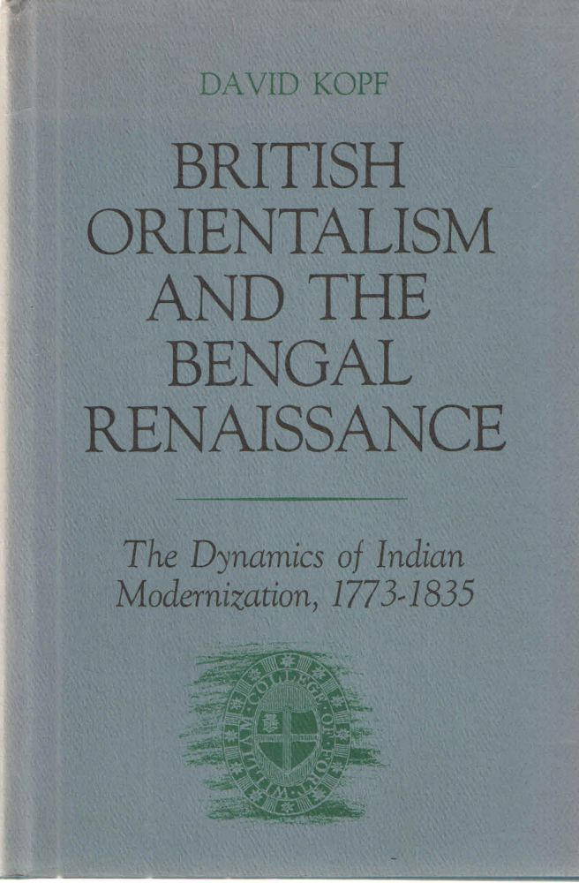
Notes:
Nineteenth-century Bengal Renaissance is characterized, on the one hand, by British impact on India and, on the other, by Indian response to Western ideas. This “intellectual awakening” is marked by conflicting currents of a broad cultural phenomenon, namely, adaptation of traditional values to modern ideas.

Slide 42
“There is only one history – the history of man. All national histories are merely chapters in the larger one.”
Rabindranath Tagore, Nationalism
Notes:
“Tagore’s perspective on the Western nation was that it constituted neither a universal model nor a necessary path of convergence. He contended that nationalism was one of Europe’s “most pernicious exports,” for it is not a child of reason or liberty, but of their opposite: of fervent romanticism, of political messianism, whose consequence, inevitably, is the annihilation of freedom. He developed an alternative conception of modernity which saw the ideas, politics and technology of the West as only one aspect of a developing historical process, rather than its core movement.
For Tagore, humanity is indivisible and societies such as India’s could redeem themselves by adopting the principles of sarvadharma samabhava (deference to all religions) or the Upanishadic dictum of vasudhev kutumbakam (the entire world as one family) which can be extended to political domain for a state of peaceful coexistence among all nations, and also within the national boundaries. It is in this spirit that he envisions a world “which has not been broken up into fragments by narrow domestic walls.” (Tagore, Gitanjali 27).”
“If India can offer to the world her solution, it will be a contribution to humanity” (Tagore, Nationalism, 78).
Satish C. Aikant, “Reading Tagore: Seductions and Perils of Nationalism,” Asiatic, Vol. 4, No. 1, (June 2010).

Slide 43
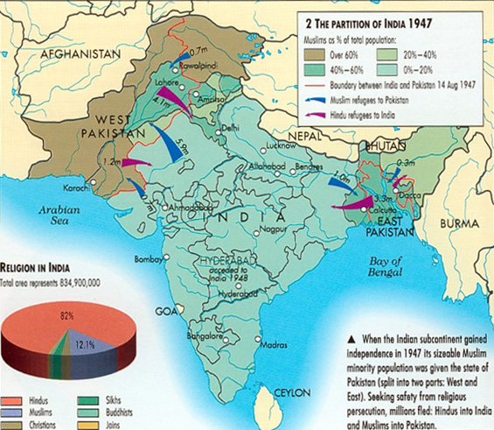
The Nationalism of Partition
A conflicted search for
modernity and nationalism
In the wake of the Partition
1947
Notes:
The Nationalism of Partition
Source: https://sites.google.com/site/globalstudiesindiaunit/home/4-1-independence-and-partition

Slide 44
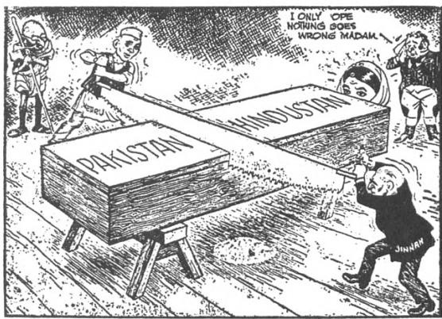
Notes:
Indian Partition and its effect on architectural history:
In India and the two wings of Pakistan (separated by 1000 miles of hostile Indian territory) the project of history became deeply complicit with the politics of national identity. Architecture and city planning became vehicles to search for roots of ethnic, religious, and linguistic identities. Religious nationalism in West Pakistan and linguistic nationalism in East Pakistan, and a progressive vision for Nehru’s India conditioned the views of architectural histories in these newly minted countries.
Source of cartoon: https://sites.google.com/site/globalstudiesindiaunit/home/4-1-independence-and-partition

Slide 45
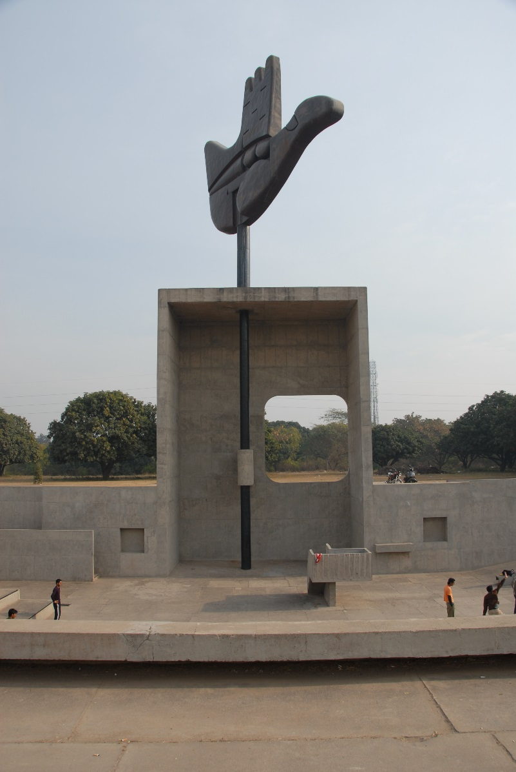
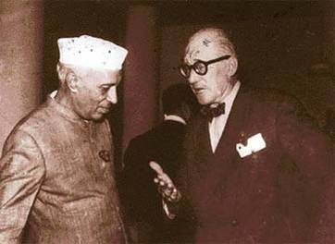
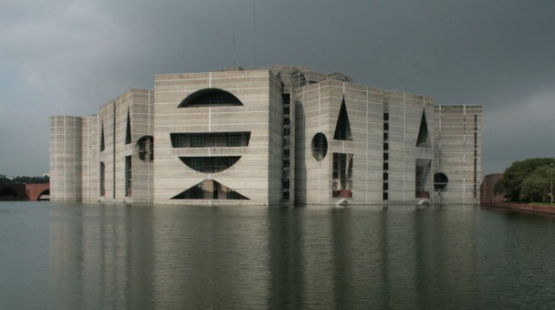
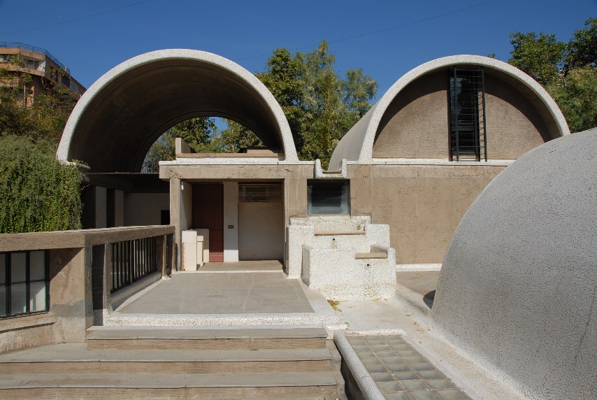
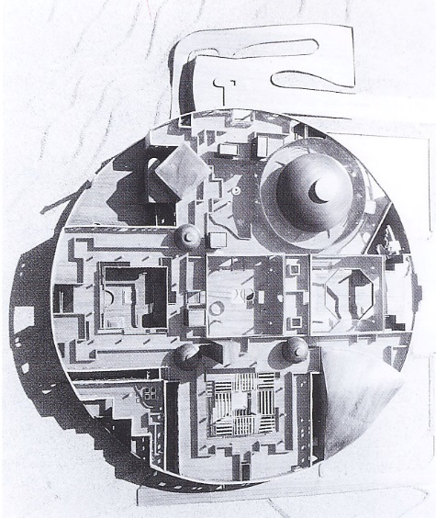
Problems of defining “modernity,” “nationalism,” and “national identity” in post-Partition South Asia
1
2
3
4
5
Notes:
Problems of defining “modernity,” “nationalism,” and “national identity” during the post-Partition period in South Asia.
Both Western and local architects found themselves in a quandary as to how to find an architecture that would embody the past and reflect the aspirations for the future.
Discuss examples, although not exclusive:
1 – Open Hand Monument in Chandigarh, Photo credit: Adnan Morshed
2 - Le Corbusier and Nehru, first prime minister of India, in Chandigarh, image source: http://www.tribuneindia.com/2003/20030831/spectrum/main1.htm
3 – Parliament Building, Dhaka, Louis Kahn, Image source: http://openbuildings.com/buildings/bangladesh-national-assembly-building-profile-2655
4 – Sangath Architect’s Office, Balkrishna Doshi, Ahmedabad, Photo credit:Adnan Morshed
5 – Bidhan Bhavan, Charles Correa, Bhopal, image source: Khan, Hassan-Uddin. Charles Correa. Mimar, 1987.

